Slide 1
HashMap
One of the most interesting topics in Java is the Map interface which represents a mapping between a key and a value. It is often misunderstood to be a subtype of Collection interface in Java.

Slide 2
Topics
Java Map Interface
Characteristics of Map Interface
Java Map Hierarchy
Methods in Java Map Interface
Implementations of Map Interface
HashMap Class
TreeMap Class
LinkedHashMap Class

Slide 3
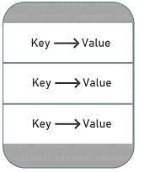
Java Map Interface
A Map in Java is an object that maps keys to values and is designed for the faster lookups. Data is stored in key-value pairs and every key is unique. Each key maps to a value hence the name map. These key-value pairs are called map entries.
In the JDK, java.util.Map is an interface that includes method signatures for insertion, removal, and retrieval of elements based on a key. With such methods, it’s a perfect tool to use for key-value association mapping such as dictionaries.

Slide 4
Characteristics of Map Interface
The Map interface is not a true subtype of Collection interface, therefore, its characteristics and behaviors are different from the rest of the collection types.
It provides three collection views – set of keys, set of key-value mappings and collection of values.
A Map cannot contain duplicate keys and each key can map to at most one value. Some implementations allow null key and null value (HashMap and LinkedHashMap) but some does not (TreeMap).
The Map interface doesn’t guarantee the order of mappings, however, it depends on the implementation. For instance, HashMap doesn’t guarantee the order of mappings but TreeMap does.
AbstractMap class provides a skeletal implementation of the Java Map interface and most of the Map concrete classes extend AbstractMap class and implement required methods.

Slide 5
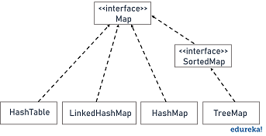
Java Map Hierarchy
There are two interfaces that implement the Map in java: Map and SortedMap. And popular implementation classes of Map in Java are HashMap, TreeMap, and LinkedHashMap. The hierarchy of Java Map is given below:

Slide 6
Methods in Java Map Interface
Methods | Description
public put(Object key, Object value) | This method inserts an entry in the map
public void putAll(Map map) | This method inserts the specified map in this map
public Object remove(Object key) | It is used to delete an entry for the specified key
public Set keySet() | It returns the Set view containing all the keys
public Set entrySet() | It returns the Set view containing all the keys and values
void clear() | It is used to reset the map
public void putIfAbsent(K key, V value) | It inserts the specified value with the specified key in the map only if it is not already specified
public Object get(Object key) | It returns the value for the specified key
public boolean containsKey(Object key) | It is used to search the specified key from this map

Slide 7
There are several classes that implement the Java Map but three major and general-purpose implementations are HashMap, TreeMap, and LinkedHashMap. Let’s see the characteristics and behaviors of each implementation with an example program.

